Slide 1
The Cenozoic
The magmatic madness ends
Erosion begins
Peneplain formation
Basin and Range normal faulting
Glaciation
Notes:
Mesozoic magmatic madness ends in the Cenozoic.

Slide 2
Western Intrusive Suite
Tuolumne Intrusive Suite
North American Plate
NEVADAN OROGENY
Farallon Plate
Notes:
As it did during the Nevadan Orogeny, the Farallon Plate continued to subduct under North America …

Slide 3
Tuolumne Intrusive Suite
North American Plate
Farallon Plate
Notes:
… but the accelerating westward motion of the North American Plate ….

Slide 4
LARAMIDE OROGENY
North American Plate
younger crust
Farallon Plate
Notes:
… combined with ever younger and more buoyant crust arriving at the subduction zone…

Slide 5
MID-CENOZOIC
LARAMIDE OROGENY
Peneplain
North American Plate
younger crust
LARAMIDE OROGENY
Farallon Plate
Notes:
… caused the uplift and erosion of the leading edge of the North American Plate. By the Mid-Cenozoic erosion had exposed the Sierra Nevada Batholith and a vast peneplain sloped towards the ocean.

Slide 6
Peneplain
Merced River
Notes:
Across this peneplain the Merced and several other Sierra Nevada rivers flowed. Because the gradient was very low, these rivers did little down-cutting.

Slide 7
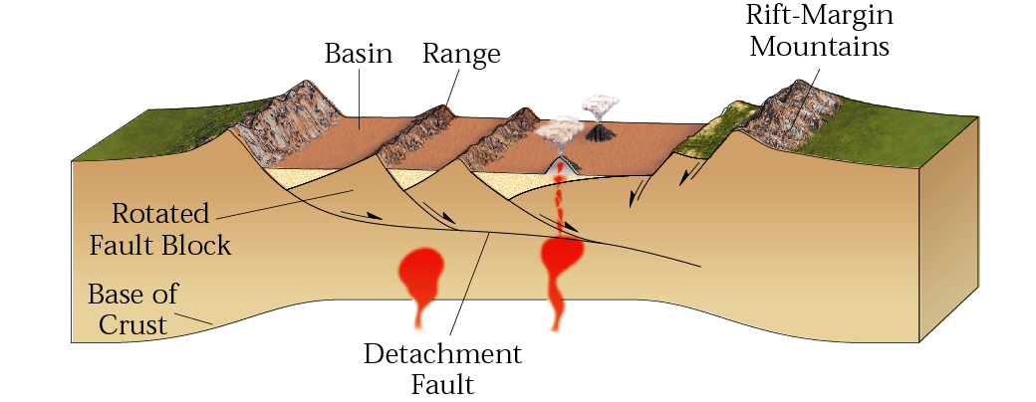
BASIN AND RANGE PROVINCE
Marshak, EARTH (Norton, 2005)
Parks and Plates
©2005 Robert J. Lillie
Notes:
But that will change considerably when the arrival of the Pacific Plate at the trench changes stress patterns from compression to shear stress and extension. Not only did this event initiate the formation of the Basin and Range Province …

Slide 8
Sierra Nevada
Marshak, EARTH (Norton, 2005)
Parks and Plates
©2005 Robert J. Lillie
Notes:
… but at the same time the entire Sierra Block uplifts along a regional-scale normal fault.

Slide 9
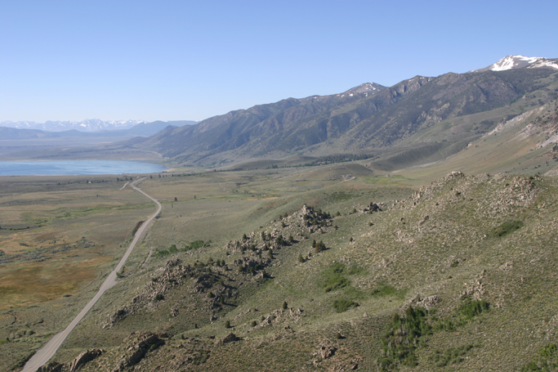
Yosemite National Park
Fault Escarpment
Mono Lakes
Robert J. Lillie
Parks and Plates
©2005 Robert J. Lillie
Notes:
That creates a steep fault escarpment bordering the Basin and Range Province on the east side of the Sierra Nevada, …

Slide 10
Eastern edge of
Yosemite National Park, California
Fault Escarpment
Robert J. Lillie
Parks and Plates
©2005 Robert J. Lillie
Notes:
… and an arrangement similar in appearance to the Grand Tetons.

Slide 11
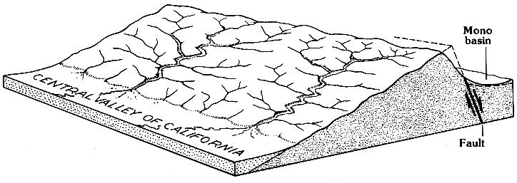
Gradient
only slightly increased
Gradient
greatly increased
11,000m
Notes:
At 11,000 meters, displacement on the Sierra fault is much less than on the Teton Fault, but that uplift is very young and it has been accelerating. Uplift tilted the Sierran Block to the west, greatly increasing stream gradient for the main east-west flowing streams like the Merced, but it had much less effect on the more north-south oriented tributaries.

Slide 12
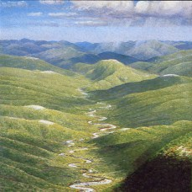
Pre-uplift Merced River 50 million years ago
Notes:
This caused the old, relatively stable Merced River …

Slide 13
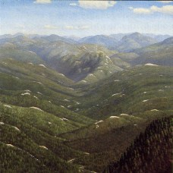
Early-uplift Merced River 10 million years ago
Notes:
… to down-cut into its canyon…

Slide 14
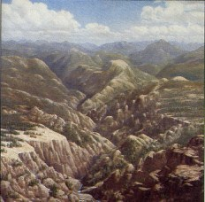
Late-uplift Merced River 3 million years ago
hanging valley
Notes:
… and to a much lower elevation along the high gradient main channel relative to its low gradient tributaries. The smaller, less down-cut tributaries dropped-off steeply where they entered the main canyon, forming “hanging valleys”.

Slide 15
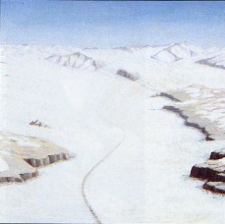
Yosemite Valley
1 million – 250,000 years ago
Notes:
Pleistocene glaciation will accentuate this relationship …

Slide 16
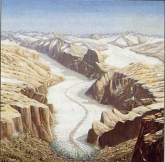
Yosemite Valley
30,000 years ago
Notes:
… as large glaciers have far more erosive power than small glaciers.

Slide 17
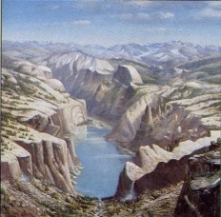
Yosemite Valley
10,000 years ago
hanging valley
Notes:
Although hanging valleys are certainly a characteristic feature of glaciated landscapes, the exceptional drop-offs of Yosemite’s are in part due to pre-existing hanging valleys created by river erosion.

Slide 18
Uplift caused erosion and unloading
Notes:
All that uplift and erosion unloaded the weight of 1000’s of meters of rock overlying the plutons.

Slide 19
Joints
Master
Lesser
Sheet
Notes:
The resultant reduction in pressure was one of the main reasons for the formation of joints within the plutonic rocks. Joints are rock fractures along which no displacement has taken place. Three joint types occur in Yosemite National Park and they play a major role in the development of many of the park’s landforms. Master joints are regional in extent, but widely spaced.

Slide 20
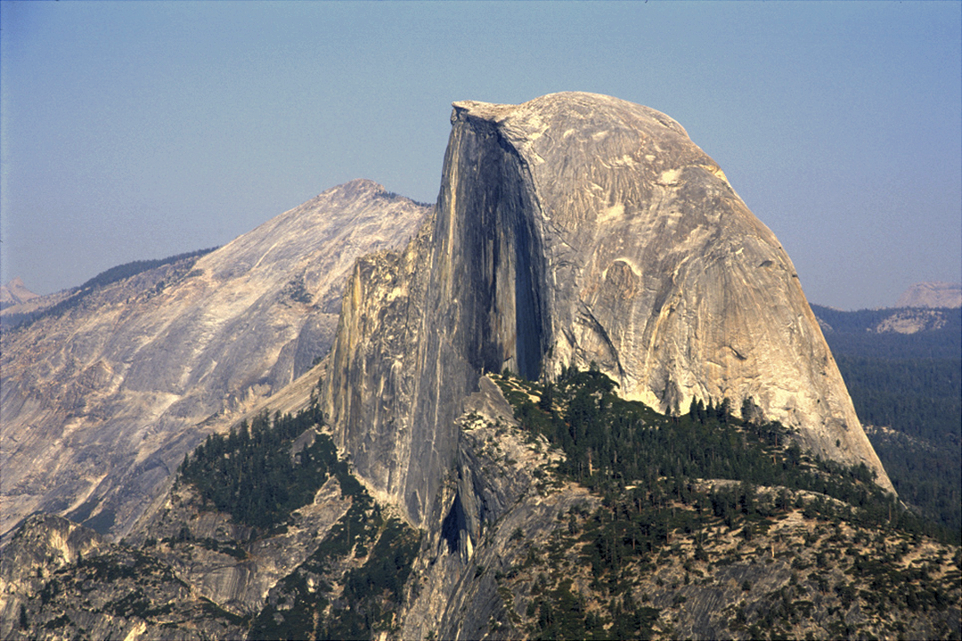
Mother of all master joints
Notes:
Half Dome’s near-vertical north face is a prime example of a master joint. Such joints probably are related to regional tectonic stress.

Slide 21
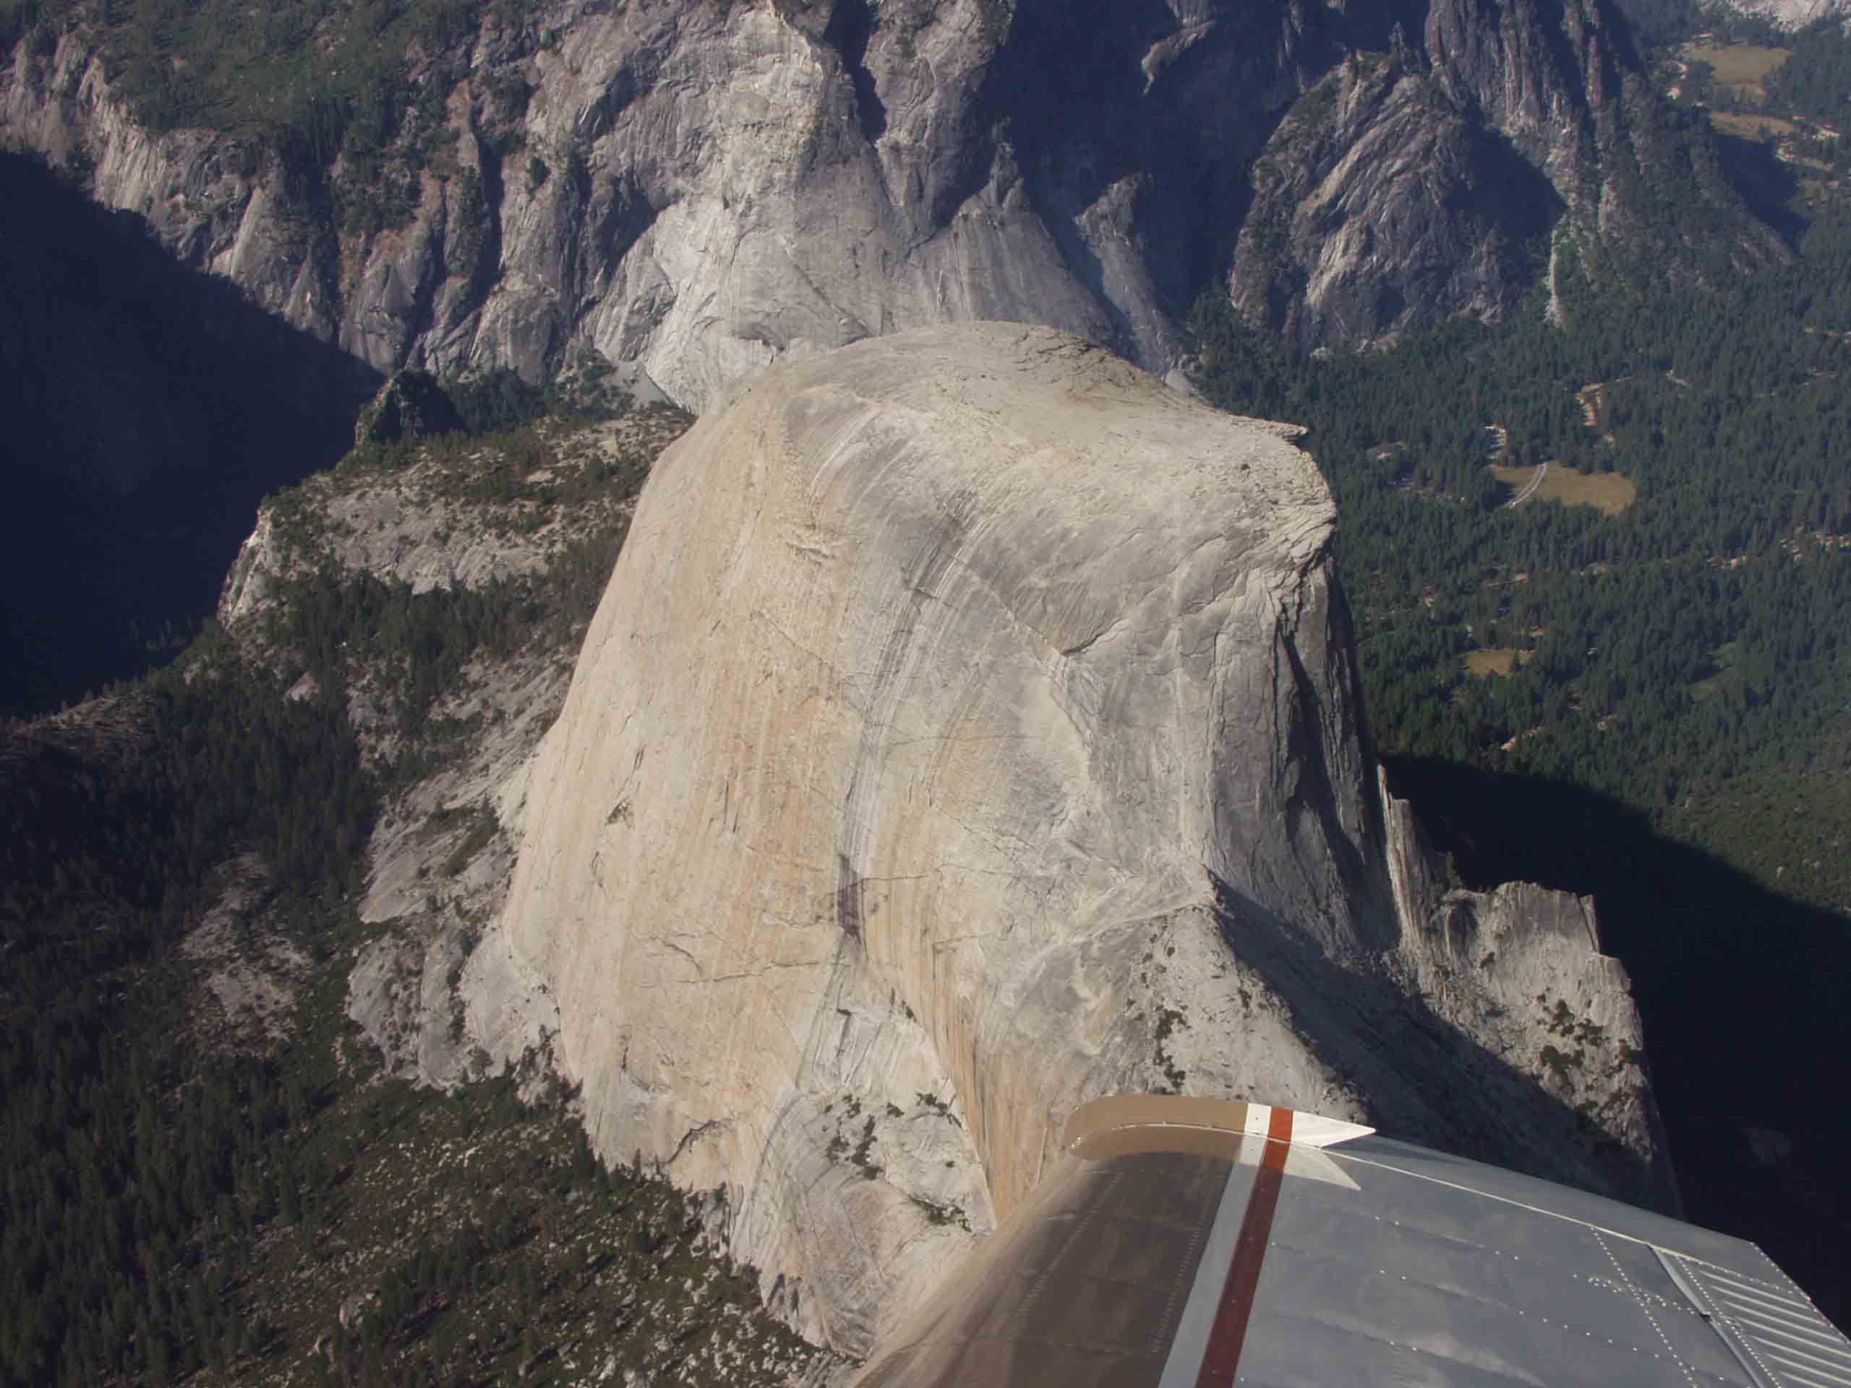
Master joint
Notes:
From this rarely seen aerial perspective of Half Dome you can see a second master joint shaping its back side.

Slide 22
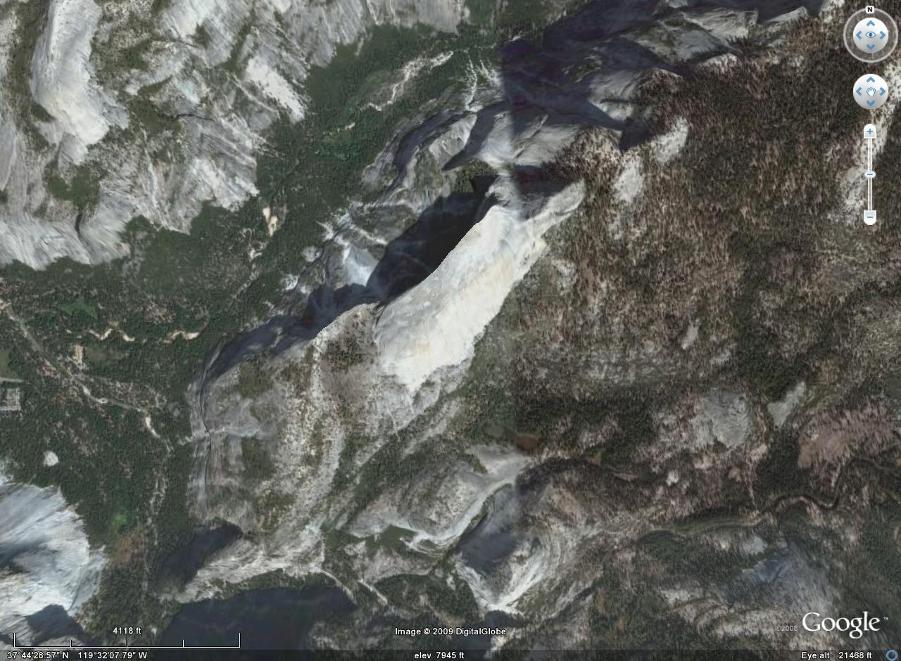
Master joints
Notes:
Looking straight down Half Dome you can see how its shape is not truly dome-like but, rather, is distinctly elongated parallel to the master joints.

Slide 23
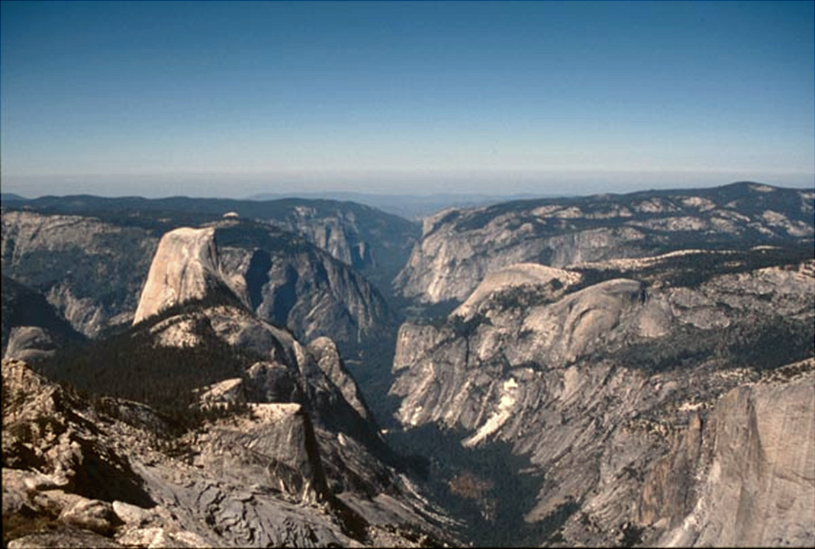
Lesser joints
Notes:
A complex system of more closely-spaced, “lesser joints” lie buried beneath the valley’s sediments, weakening the rock and facilitating both stream and glacial erosion. Such joints can form by contraction associated with pluton cooling.

Slide 24
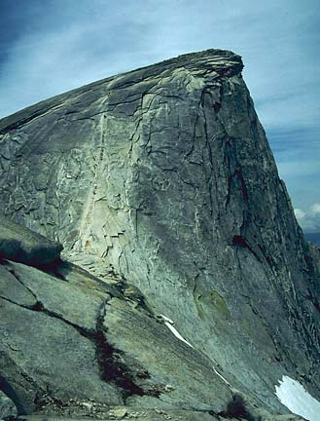
Sheet Joints
Notes:
The third type of joint, the skin-like “sheet joints” are most obvious on the top of Half Dome, …

Slide 25
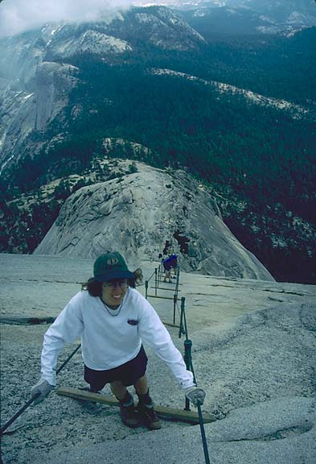
Notes:
… which can be accessed via the infamous cable route. From this perspective you can see that Half Dome is more of a rounded-off vertical slab rather than a semi-circular dome.

Slide 26
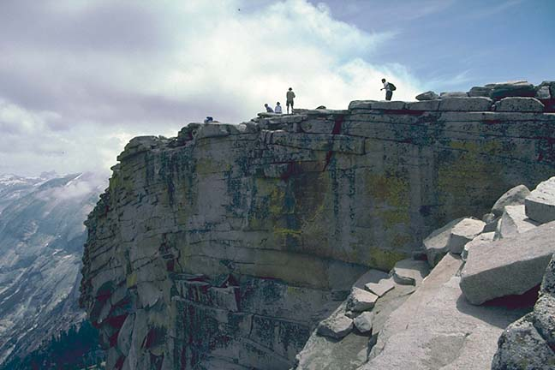
Concentric sheet joints on Half Dome
Notes:
The rounding is due to the action of sheet joints which are prominent on the top of Half Dome. Sheet Joints form from expansion due to pressure release as erosion removes the massive weight of rock that once sat on top of the plutons.

Slide 27
Concentric sheet joints on Half Dome
less pressure
more pressure
Notes:
Because the pressure reduction on the top of the pluton is greater than in the pluton’s interior, …

Slide 28
Concentric sheet joints on Half Dome
more expansion
less expansion
Notes:
… the amount of expansion is greatest near the surface. To accommodate the differential expansion, sheet joints therefore form parallel to the surface in a concentric onion-like arrangement.

Slide 29
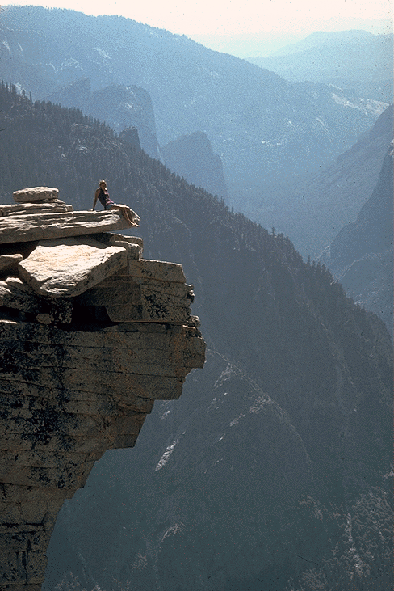
The
“Diving Board”
Notes:
Frost wedging and other processes widen and loosen the joint-bounded slabs until they eventually slide off …

Slide 30
Huh?
!!!
The
“Diving Board”

Slide 31
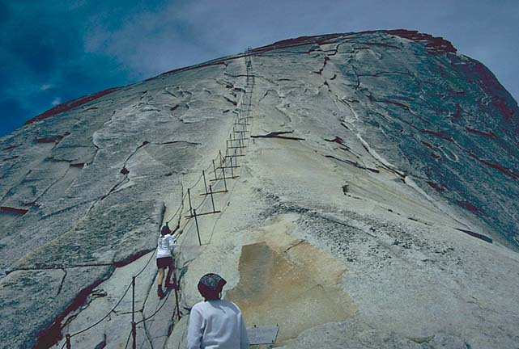
Exfoliating slab
Notes:
… in a process called exfoliation. Exfoliation ultimately smoothes and rounds the exposed plutons ….

Slide 32
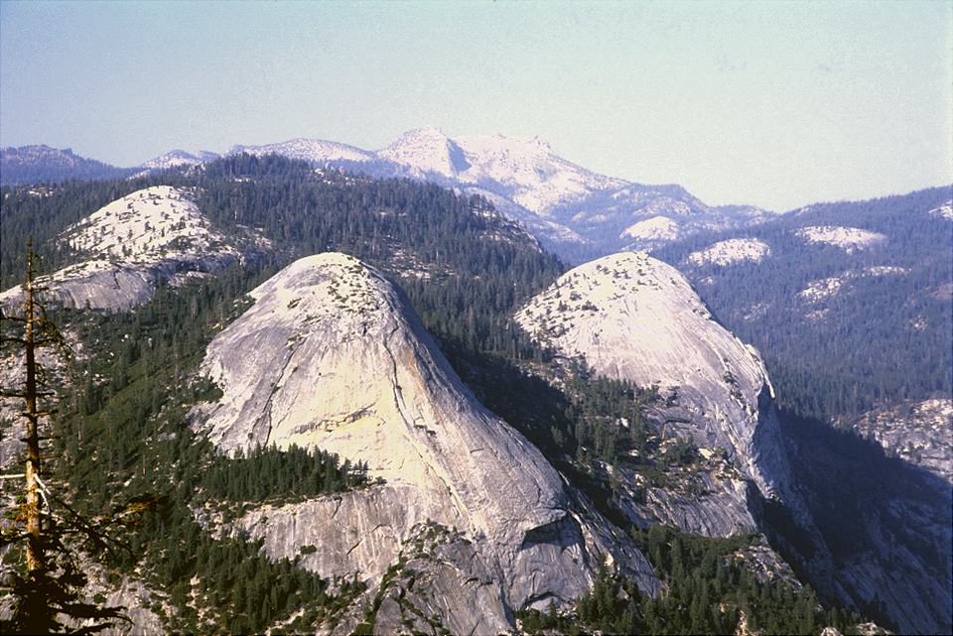
Exfoliation Domes
Notes:
… forming exfoliation domes.

Slide 33
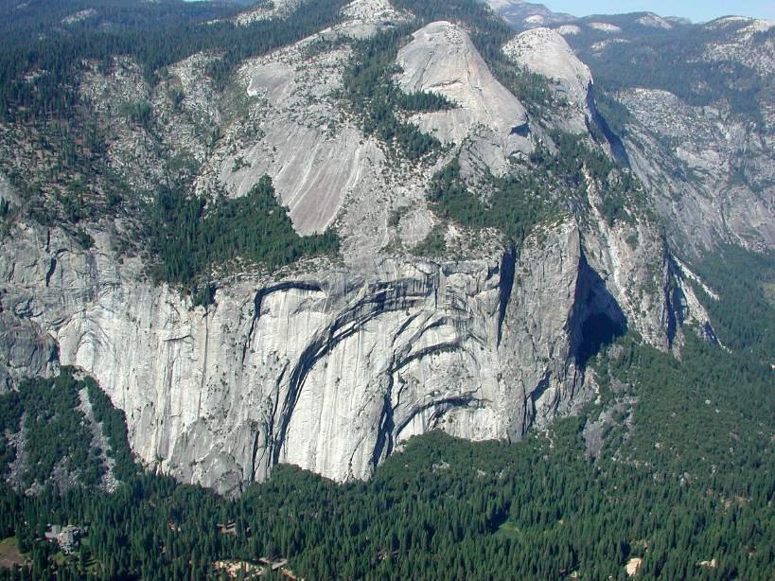
North Dome
Notes:
These lie just north of Half Dome hence the name “North Dome”.

Slide 34
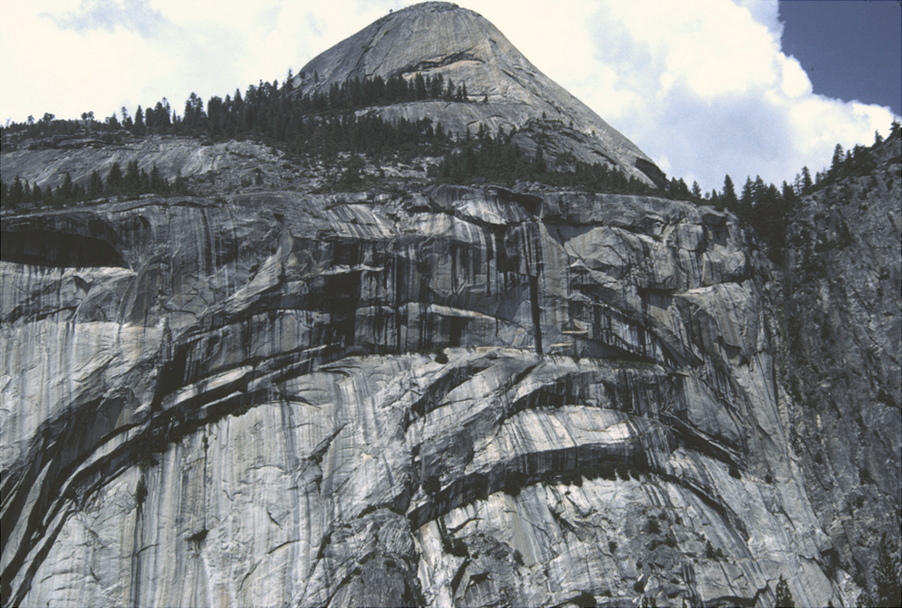
North Dome
Royal Arches
Notes:
Below North Dome lie the great sheet joints known as the Royal Arches. These are somewhat special sheet joints in that they formed in response to the release of pressure on the wall of the valley as glacial erosion of the valley removed the confining pressure on these rocks. Nonetheless, they ultimately have the same rounding affect as all sheet joints. As these great slabs spall off, North Dome will widen and blend more seamlessly into the valley slopes.

Slide 35
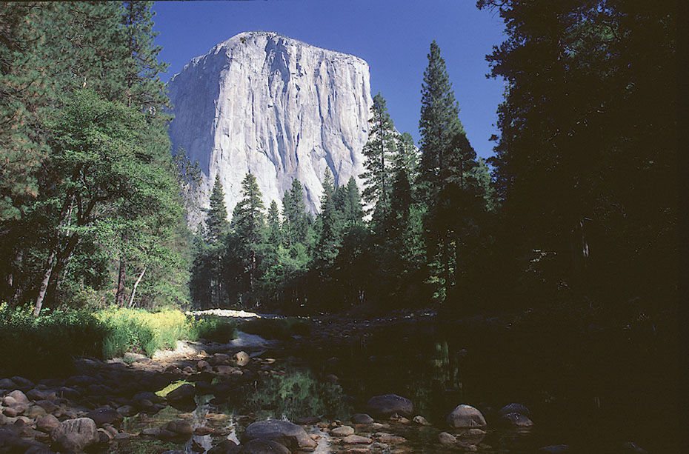
Massive, not jointed El Capitan
Notes:
The absence of jointing also controls topography. The massive, non-jointed El Capitan granite was strong enough to resist glacial erosion and support some of the highest vertical cliffs in the world.

Slide 36
Glaciation
Notes:
No study of the geology of Yosemite National Park is complete without a thorough discussion of the affects of Pleistocene glaciation.

Slide 37
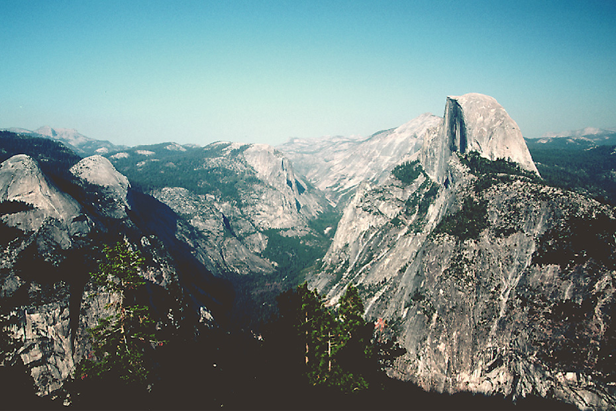
Notes:
During numerous times in the Pleistocene the entire Yosemite Valley …

Slide 38
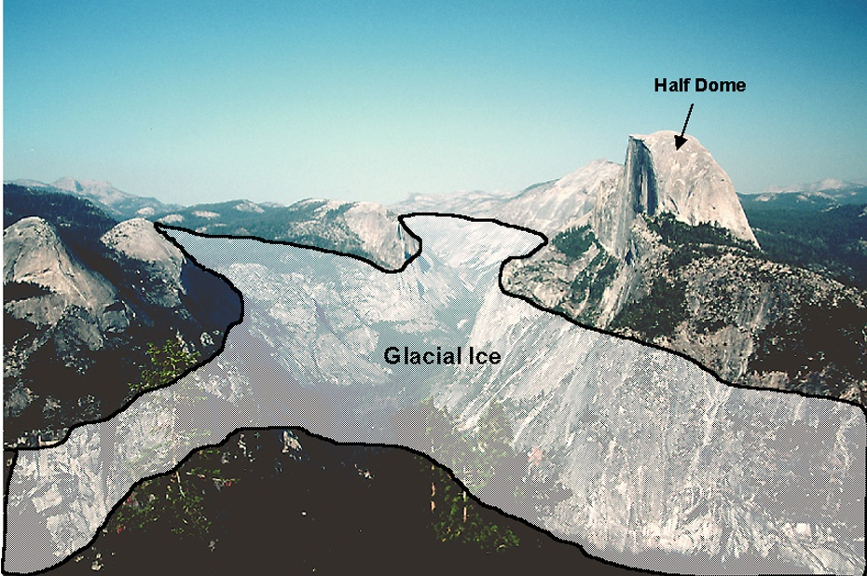
Notes:
…was covered with glacial ice.

Slide 39
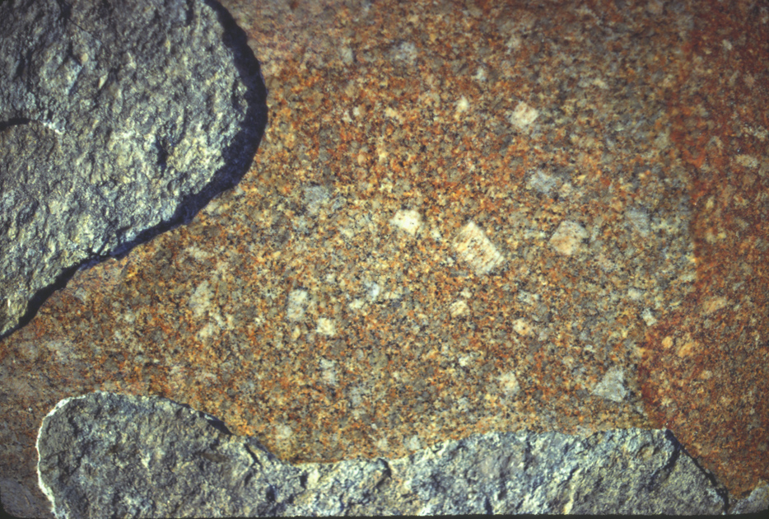
Glacial Polish
Notes:
Glacial Polish on the walls of the valley …

Slide 40
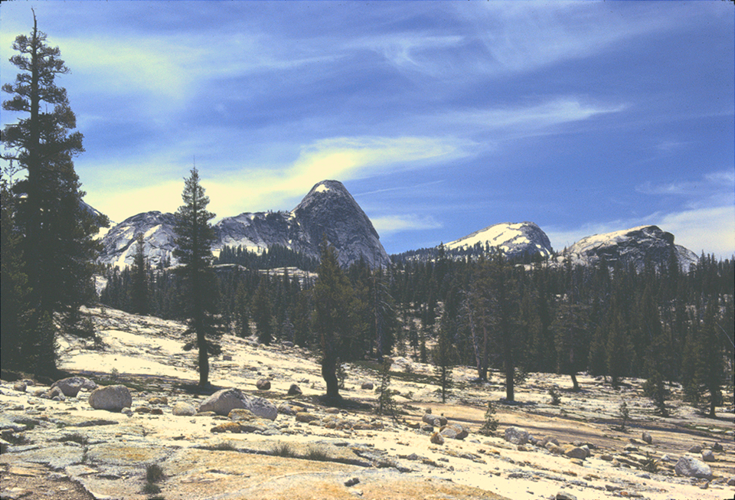
Glacial Polish
Notes:
… and importantly, above the valley rim…

Slide 41
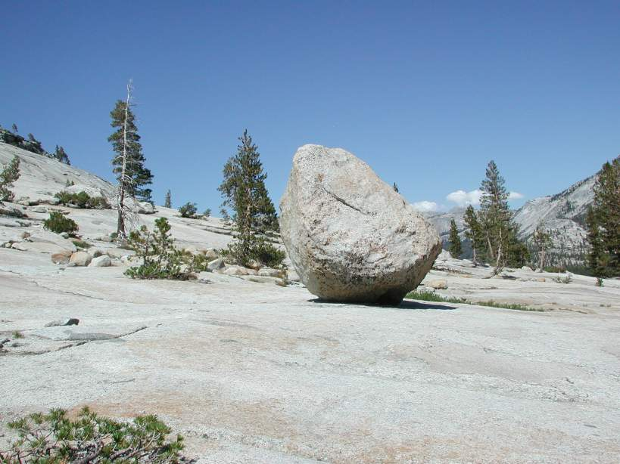
Glacial Erratic
Glacial Polish
Notes:
.. where random, ice-deposited boulders called glacial erratics rest, attest to the erosion of glaciers …

Slide 42
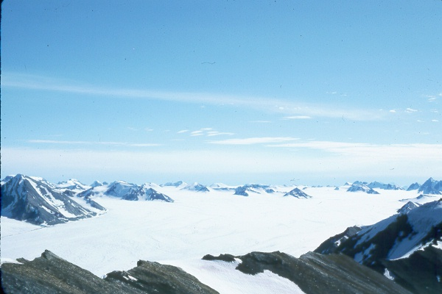
Nunataks
Notes:
… and that they spilled out from the confines of the valley on to the surrounding terrain. Ice thickness was not enough to cover the entire land surface around Yosemite and so, like this ice field in Greenland, numerous rocky peaks called Nunataks were exposed above the ice.

Slide 43
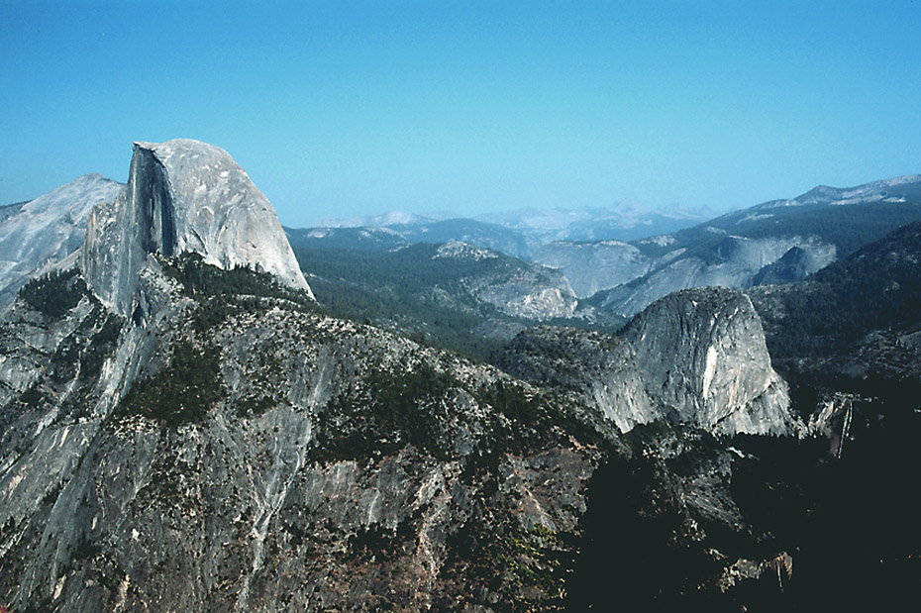
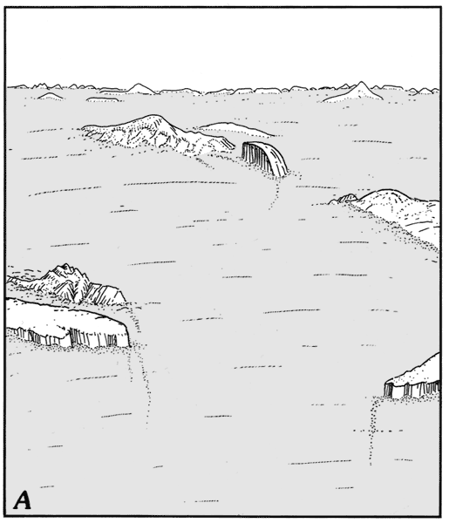
Nunatak
Notes:
Half Dome was once a Nunatak.

Slide 44
Roches Moutonnées
Notes:
Roches Moutonnees are of particular interest in Yosemite.

Slide 45
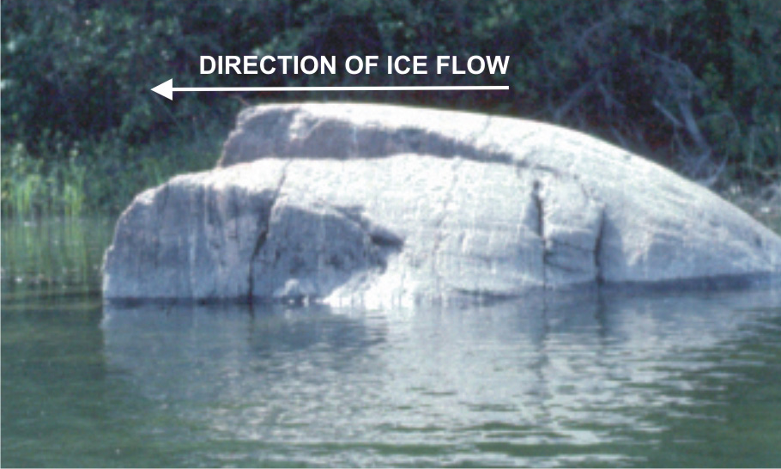
Roche Moutonnée
Notes:
You should remember them from our study of Isle Royale. Remember that the steep side forms as glacial ice freezes to jointed rock and “plucks” it away as the ice moves.

Slide 46
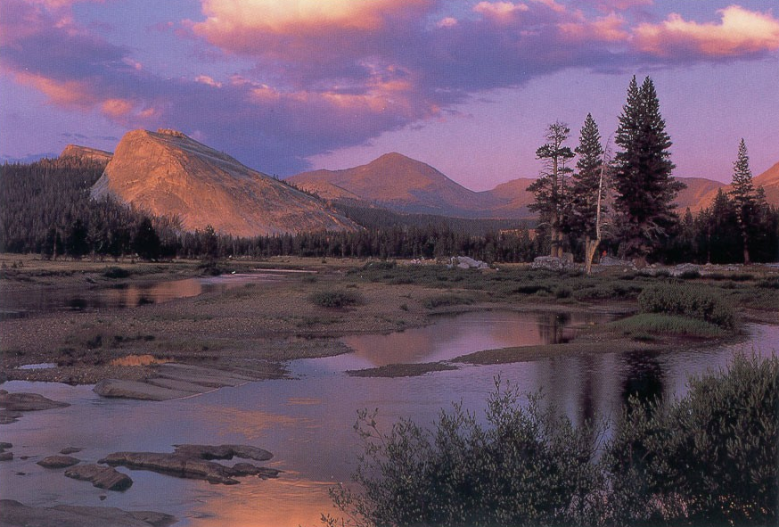
Lembert Dome
Notes:
Lembert Dome in Tuolumne Meadows is a beautiful (and huge!) example of a roche moutonnée. Can you tell which direction the glacier moved?

Slide 47
Lembert Dome
Notes:
Right to left is correct.

Slide 48
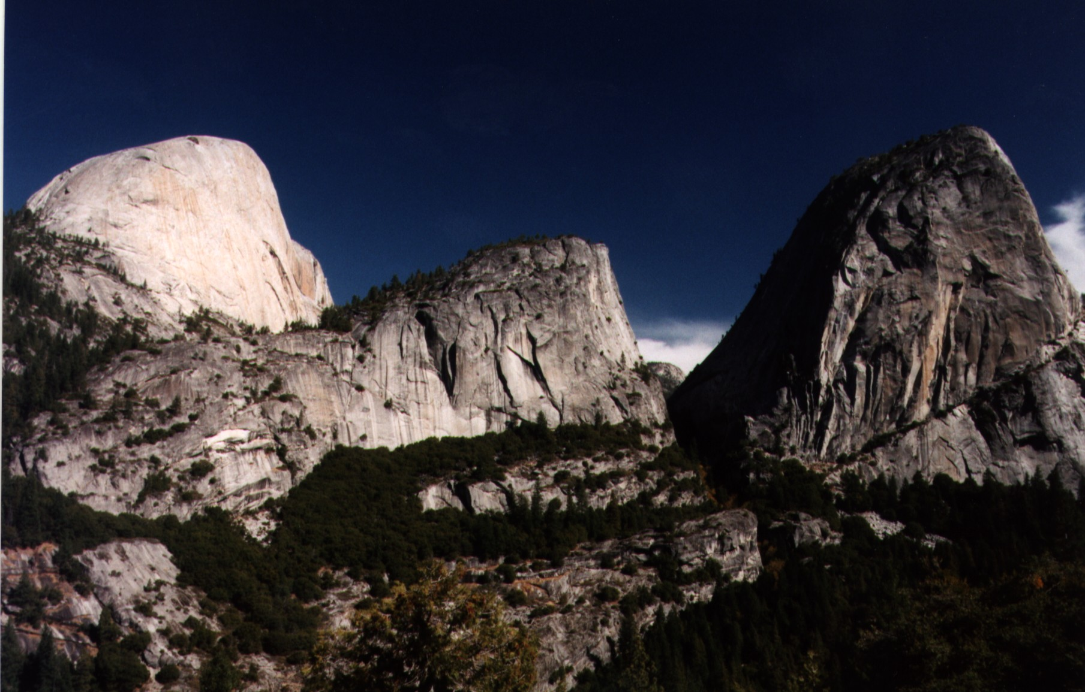
Half Dome
Liberty Cap
Mt Broderick
Notes:
Just below Half Dome lie two other good examples of roche moutonnées - Mt Broderick and Liberty Cap.

Slide 49
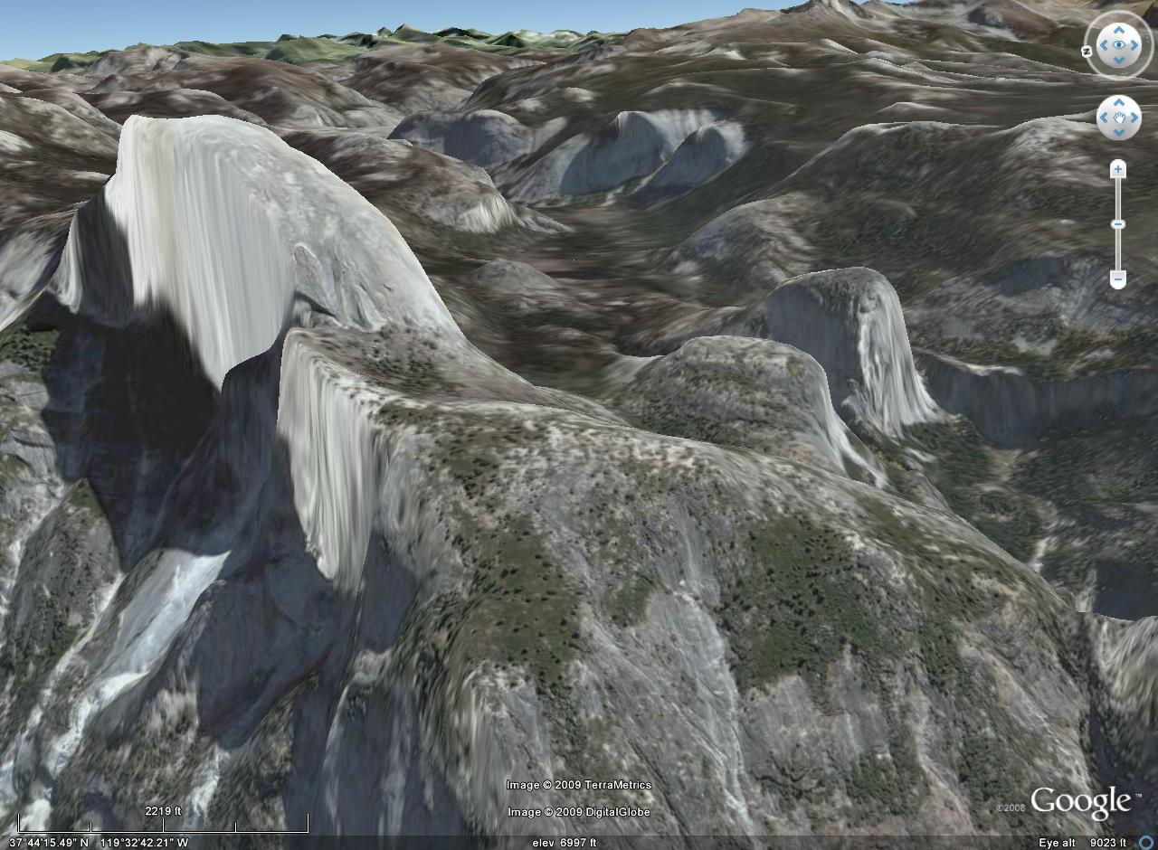
Liberty Cap
Mt Broderick
Notes:
From the right angle the characteristic roche moutonnée asymmetry is apparent.

Slide 50
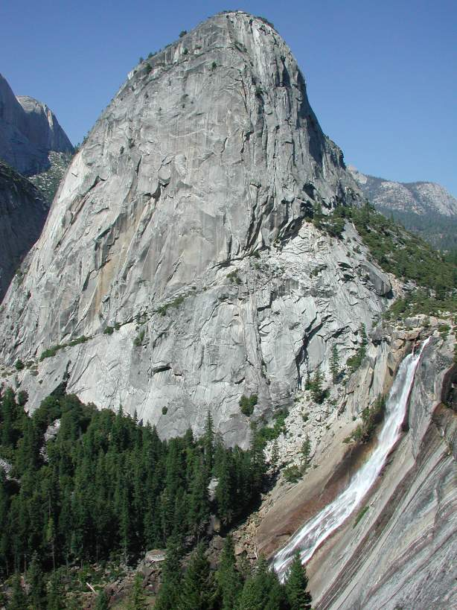
Liberty Cap
Nevada Falls
Notes:
Glacial plucking on the down flow side of Liberty Cap formed the steep drop-off down which Nevada Falls cascades.

Slide 51
WATERFALL TYPES
Glacial “Staircase” Falls
Hanging Valley Falls
Notes:
Nevada Falls belongs to a type of waterfall called a glacial “staircase” fall.

Slide 52
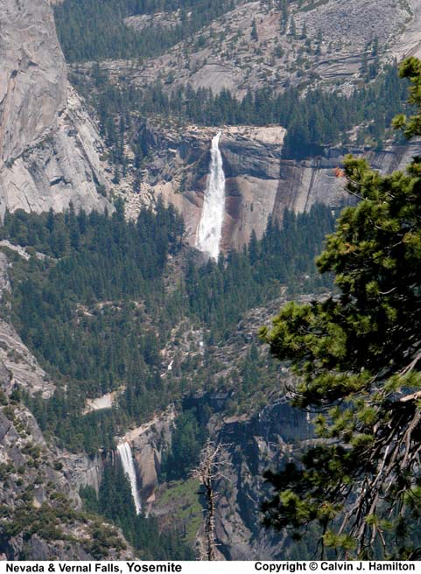
Nevada
Vernal
Notes:
Vernal Falls is part of this same “staircase”.

Slide 53
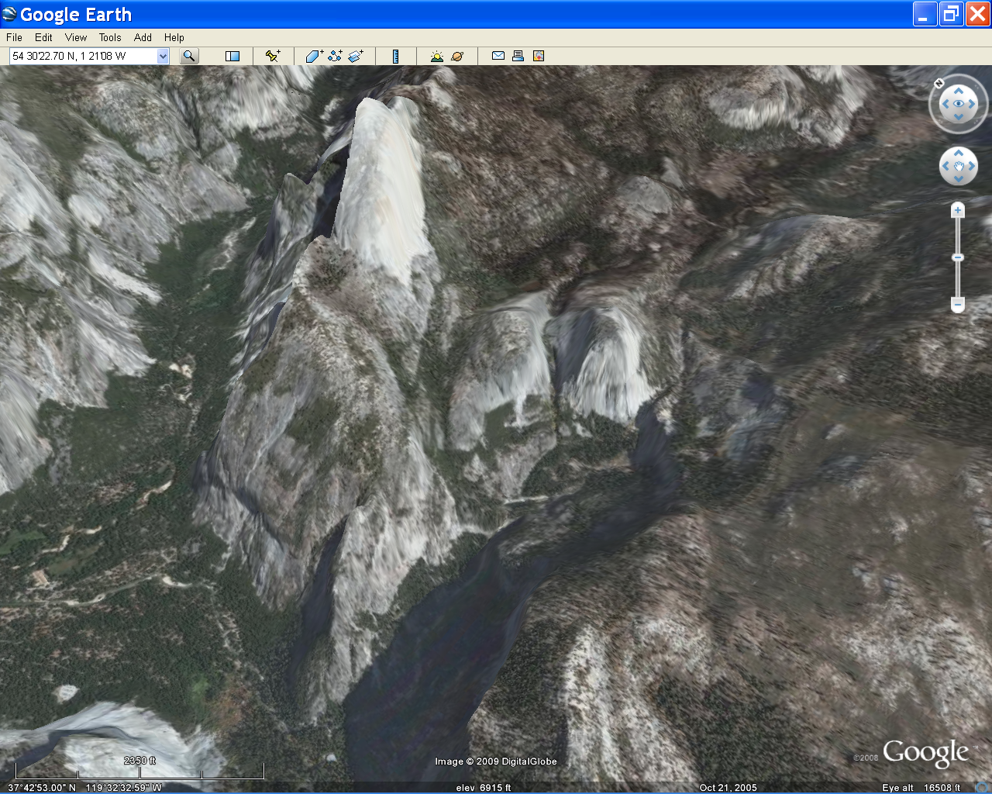
Nevada
Vernal
Notes:
If you look closely at this Google Earth view you can see that the steps that create Vernal and Nevada falls are aligned parallel to the system of master joints that were so influential in the formation of Half Dome.

Slide 54
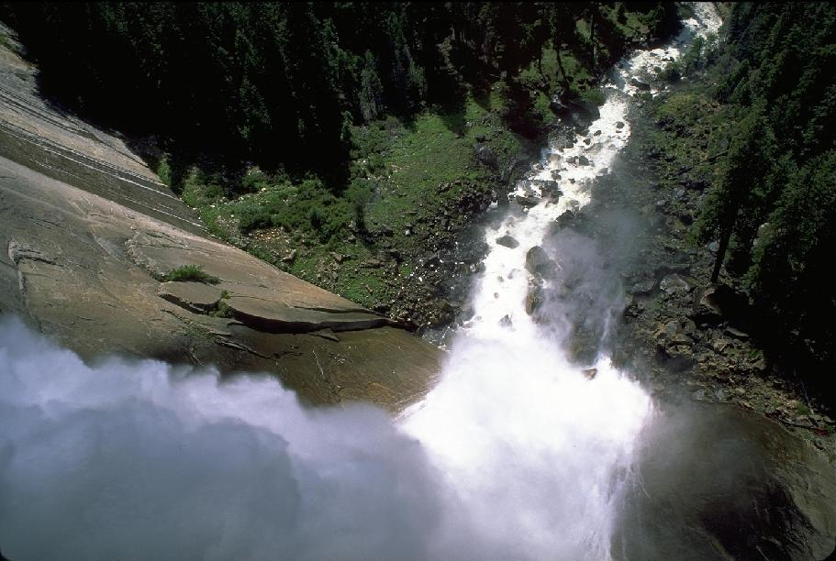
Nevada Falls
Notes:
This suicide view of Nevada Falls clearly shows the master joint surface exposed by glacial plucking.

Slide 55
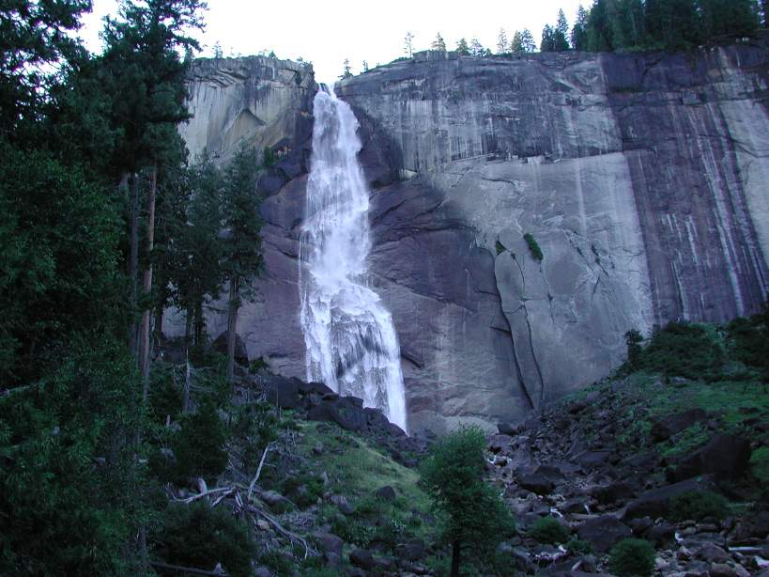
Nevada Falls
Notes:
The half-mile distance between Nevada Falls …

Slide 56
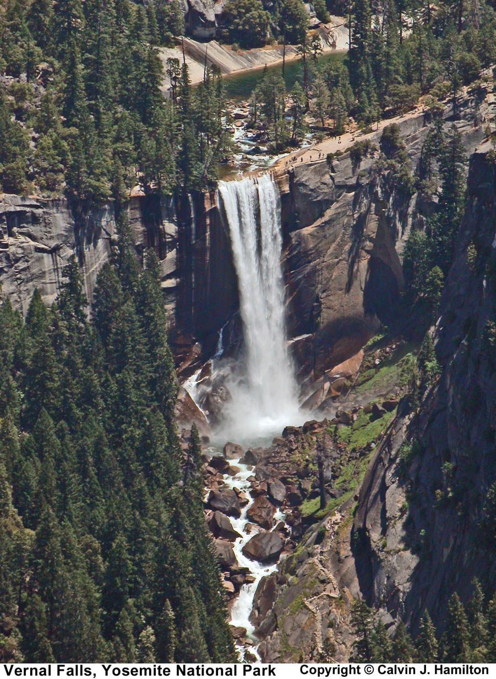
Vernal Falls
Notes:
… and Vernal Falls provides some perspective …

Slide 57
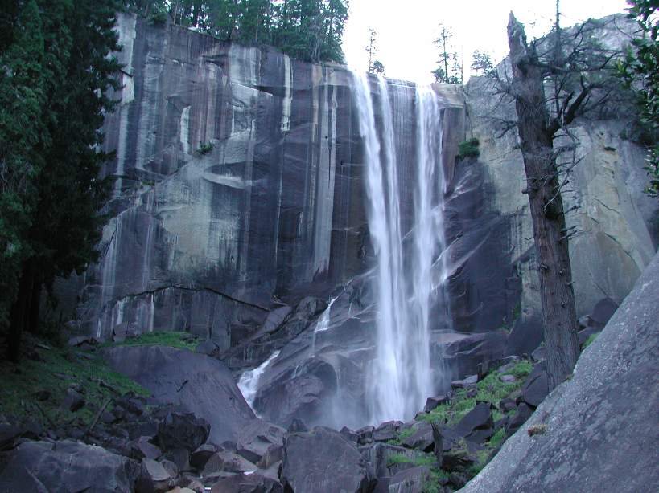
Vernal Falls Master Joint
Notes:
…on the spacing of the master joints.

Slide 58
WATERFALL TYPES
Glacial “Staircase” Falls
Hanging Valley Falls
Notes:
Yosemite’s second type of waterfall issues from the much higher hanging valleys.

Slide 59
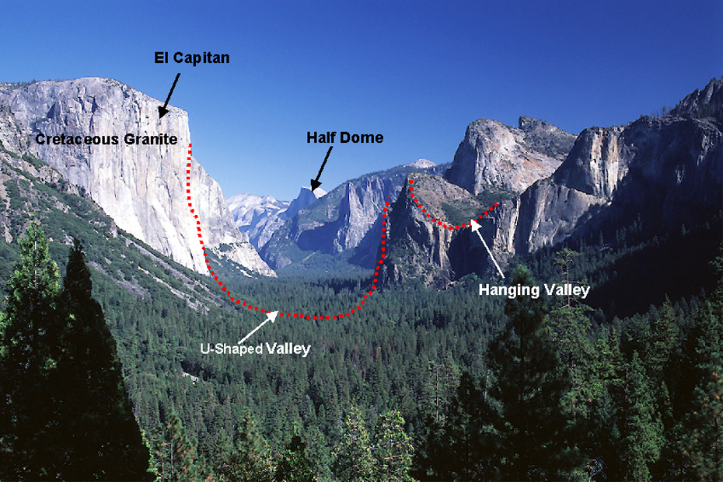
Notes:
Remember that hanging valleys form where a small glacier joins the far deeper trough of a much larger glacier.

Slide 60
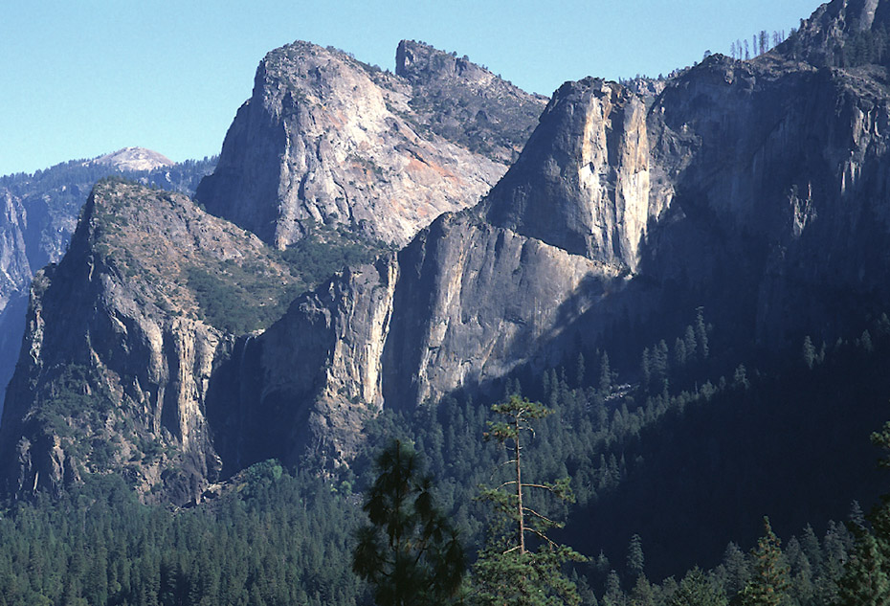
Bridal Veil Falls
Notes:
Bridal Veil Falls issues from this hanging valley and is a classic example.

Slide 61
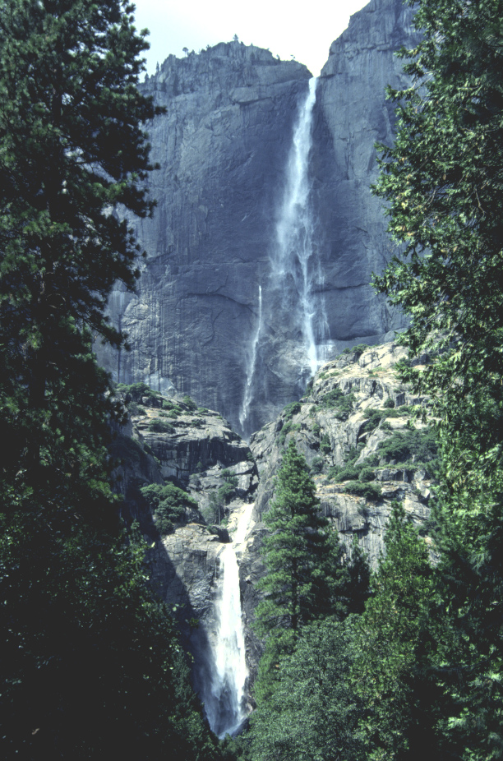
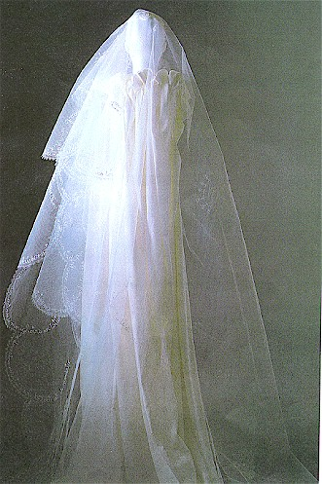
Bridal Veil
Notes:
Although one of the most popular waterfalls in the park, at 620 feet Bridal Veil is nowhere near the highest.

Slide 62
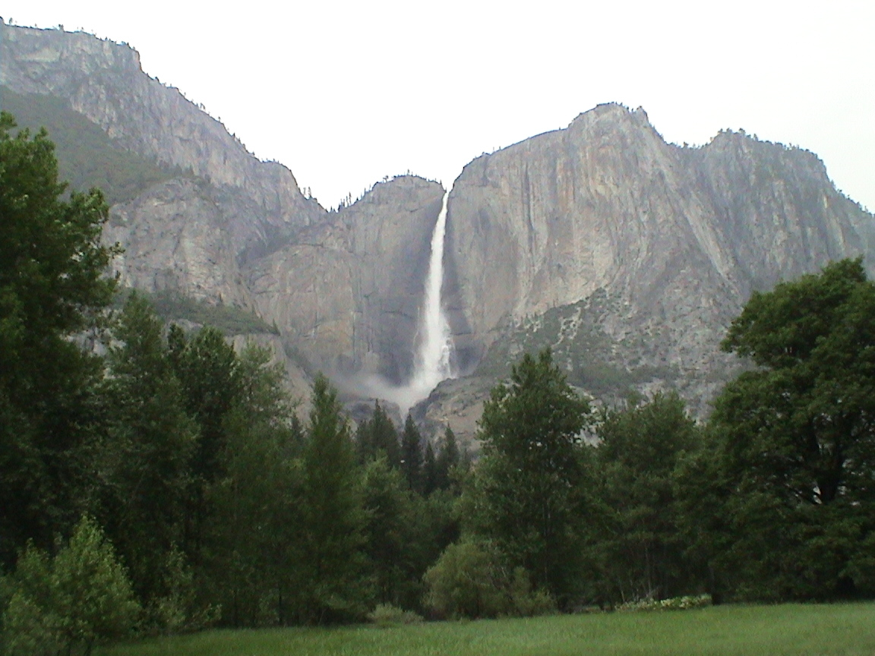
Ribbon Falls
Notes:
Ribbon Falls comes in at 1,612 feet …

Slide 63
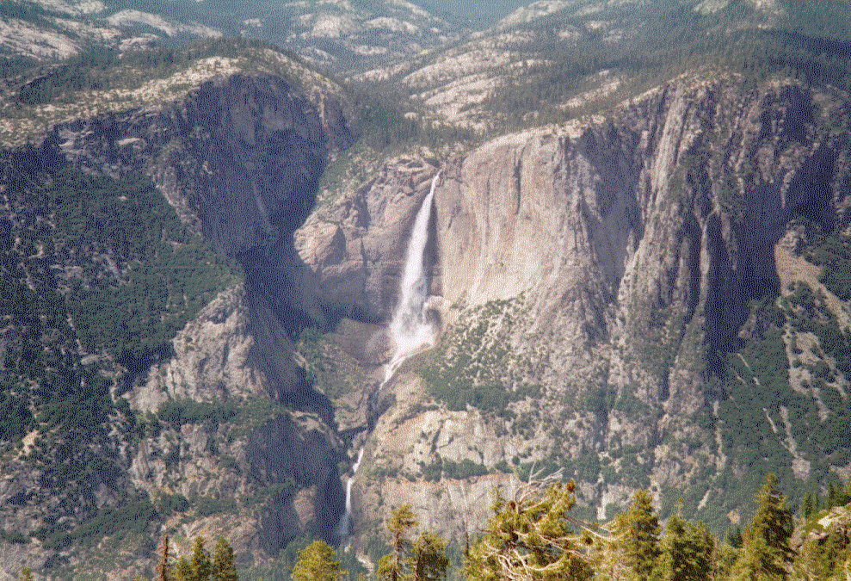
Yosemite Falls
Notes:
… and Yosemite Falls at 2,425 feet – making it the 7th highest in world. Both exemplify the terrific heights typical of hanging valley water falls.

Slide 64
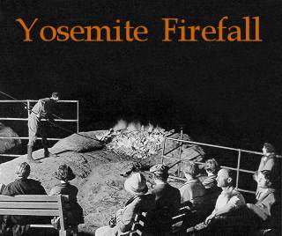
Notes:
For nearly a hundred years there was an other type of fall in Yosemite. Back in the day, a great pile of embers would be pushed nightly from the top of glacier point …

Slide 65
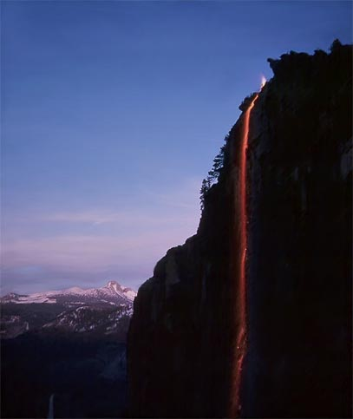
Notes:
… towards great crowds of onlookers below. Congestion and heightened environmental consciousness led to the popular attraction’s termination in 1968.

Slide 66
Glacial Deposition
Notes:
The final geologic touches on the park were applied by glacial deposition.

Slide 67
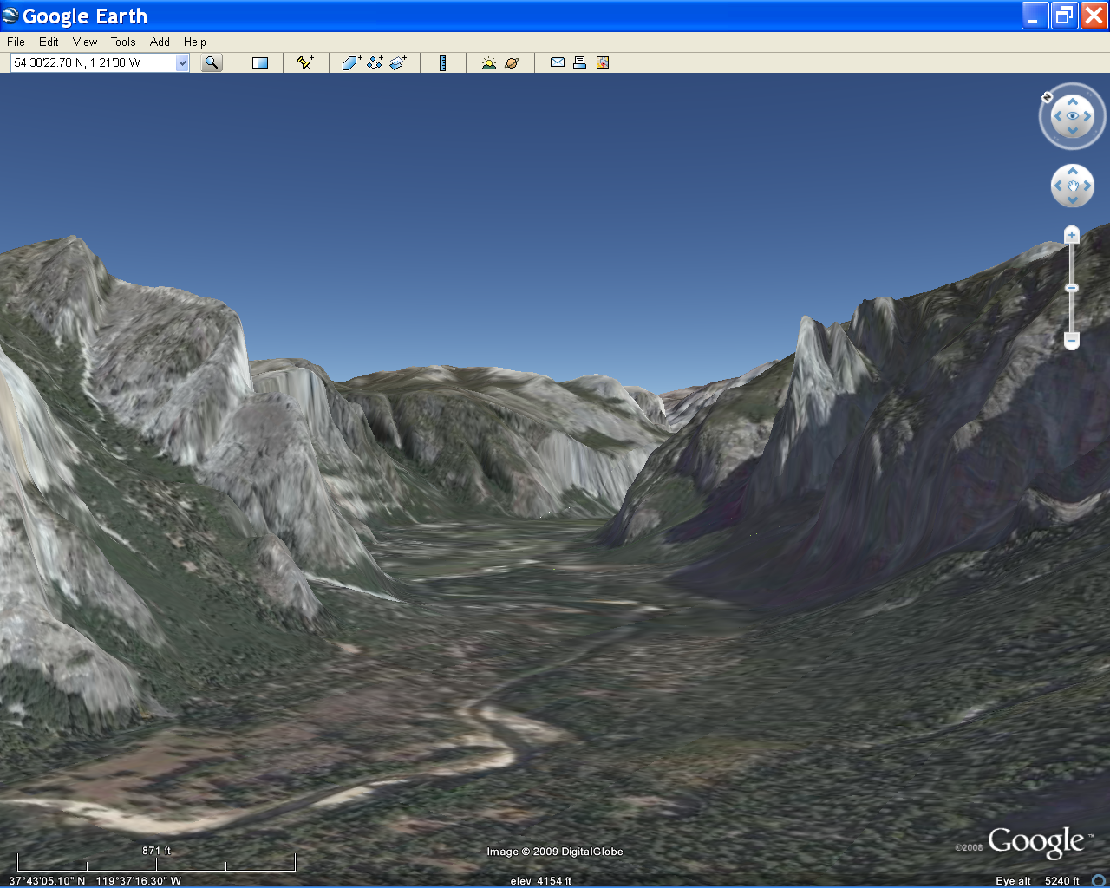
Notes:
Although touted as a classic example of a U-shaped glacial trough, you can see that the valley is actually quite flat from side to side.

Slide 68
Notes:
That’s because of the sediment that accumulated in Lake Yosemite – a large lake that formed behind a recessional moraine located below Bridal Veil Falls.

Slide 69
Notes:
Because lake sediments are more permeable than the unsorted till that makes up moraines, the water table is lower in areas where the lake sediments deposited. Lower water tables and periodic natural wildfires combine to inhibit tree growth such that only grasses survive and thus meadows form. Note that trees only grow next to the Merced River here.

Slide 70
Notes:
Meadows used to cover much more of the valley but by one estimate, they only cover 6.8% of their 1866 area.

Slide 71
Notes:
Meadow size reduction in Yosemite Valley is largely a result of human fire-suppression, which has allowed tree seedlings to gain a foot hold.

Slide 73
Notes:
Yosemite 05 RFH Half Dome at sunset. (Photo by Ronald F. Hacker)

Slide 74
Yosemite Valley from Inspiration Point
Notes:
Famed nature photographer Ansel Adams once said of
No matter how sophisticated you may be, a large granite mountain cannot be denied - it speaks in silence to the very core of your being” Those are the words of

Slide 75
To make Yosemite National Park, go to Mt. Rainier National Park and erode the volcano away!
Robert J. Lillie
Robert J. Lillie
Robert J. Lillie
Robert J. Lillie
Parks and Plates
©2005 Robert J. Lillie
Notes:
To make Yosemite National Park, go to Mt. Rainier National Park and erode the volcano away! You might recall that the bulk of Mt. Rainier was made of andesite – a fine-grained volcanic rock of intermediate composition. But also recall that all that Mt. Rainier is built on the

Slide 76
Magma Chamber
Uplift and Erosion
Parks and Plates
©2005 Robert J. Lillie

Slide 78
El Capitan Granite

Slide 79
Notes:
Yosemite 29 RFH Igneous intrusion within granite. (Photo by Ronald F. Hacker)

Slide 80
Cathedral Peak Granodiorite with stained K-spar.
Texture produced by a pause during cooling.
Notes:
Abstract
Microcline megacrysts in the Cathedral Peak Granodiorite and other parts of the Tuolumne Intrusive Suite were formed by textural coarsening (Ostwald Ripening) of earlier formed crystals. The early-formed crystals nucleated and grew in an environment of increasing undercooling, probably during the ascent of the magma. Emplacement of the magma into warm host-rocks promoted textural coarsening. Crystals smaller than a certain size (the critical size) dissolved in the interstitial melt whilst larger crystals grew. Microcline was most sensitive to this effect as the magma temperature was buffered close to its liquidus for a long period by the release of latent heat of crystallisation. Positive feedback between textural coarsening and magma permeability channeled the flow of interstitial melt to produce a heterogeneous distribution of megacrysts. Megacryst growth was halted when cooling resumed at the end of the intrusive cycle. K-feldspar nucleation was then renewed and K-feldspar crystals grew to form part of the groundmass. It was the particular thermal history of this pluton that promoted textural coarsening – chemically similar plutons that lack megacrysts probably did not have the pause during cooling that was necessary for the development of this texture.

Slide 81
Think again!
Notes:
Well think again

Slide 82
Notes:
"SEDIMENTARY" STRUCTURES IN A LAYERED GRANODIORITE: AN EXAMPLE OF MAGMA MULTIPHASE DYNAMICS FROM THE TUOLUMNE INTRUSIVE SUITE, SIERRA NEVADA, CALIFORNIA
JAMES, Loetterle and BERGANTZ, George W., Earth Space Sciences, Univ of Washington, Box 351310, Seattle, WA 98195, jletter@u.washington.edu The Tuolumne Intrusive Suite (TIS) is a type example of a concentrically zoned, composite, intrusive body. Mapping, geochronology and limited chemical analyses have led to the suggestion that magma was episodically assembled into the TIS. However, the physical processes that contribute to the shared characteristics in the units of the TIS are not obvious, due to the special rheological requirements for the preservation of fluid processes. Hence the sparse sedimentary-type features exposed in layered outcrops of the TIS provide a unique opportunity to assess fluid dynamic processes.
Outcrops of centimeter scale, rhythmic, modally graded layers have been mapped near the eastern margin of the TIS, locally cross-cutting all members of the suite. This layering involves all mineral phases, demonstrating ‘fluidity’ up to moderate degrees of crystallinity. The layering is different than other seemingly dynamic features such as ladder-dikes and schieren, or K-spar rich magma “worms.” Some layers of granodiorite demonstrate features similar to cross bedding in sedimentary rocks. Other layers display slumping or truncation of bedding similar to soft-sediment deformation. In some cases a sharp, sub-planar, upper and/or lower contact of the layers is visible. In all cases dikes containing K-spar megacrysts cross cut the layers. Field relations suggest that the layers occupy "slot-like" openings in the Kuna Crest and Half Dome granodiorites. This is similar to the geometry invoked by Clarke and Clarke (1998) for layered outcrops of granodiorite in the South Mountain Batholith of Nova Scotia. However, the TIS layers appear to originate by dynamic deposition rather than in-situ crystal growth. The layers capture the process of Cathedral Peak magma being drawn into near horizontal planar conduits. As the process is repeated, rhythmic layers develop. 2003 Seattle Annual Meeting (November 2–5, 2003)

Slide 85
Peneplain
Half Dome
Notes:
You can

Slide 86
Peneplain

Slide 87
Notes:
Yosemite 2 RFH Half Dome from Glacier Point. (Photo by Ronald F. Hacker)

Slide 89
Notes:
Mt Broderick and Liberty Cap were covered by glaciers

Slide 90
Notes:
Yosemite 01A RFH Yosemite Valley. (Photo by Ronald F. Hacker)

